Slide 1
Excel
Grade 12 CAT

Slide 2
If
If it is sunny we will go to the beach, if it rains we will stay at home
This function is used when you have a choice of two options:
If you get over 40% you have passed, otherwise you have failed →

Slide 4
Use Autofill
Change some numbers
to see the effect

Slide 5
Nested If
This is an IF statement Inside an IF statement
If it is sunny we can go to the beach or we can go for a drive, if it rains we will stay at home

Slide 6
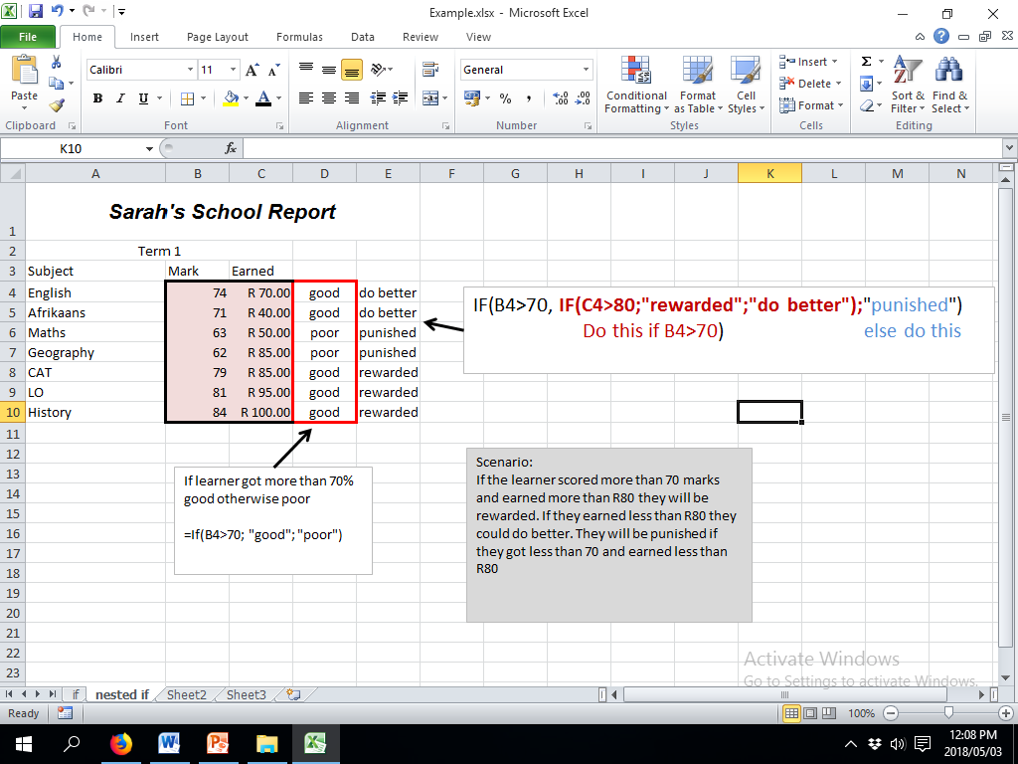

Slide 7
Vlookup
This function is used when you need to get a value from another place in the spreadsheet or from another sheet in the file.
Work out the first one in the column then autofill.
In the formula a sheet reference has ! After it.

Slide 8
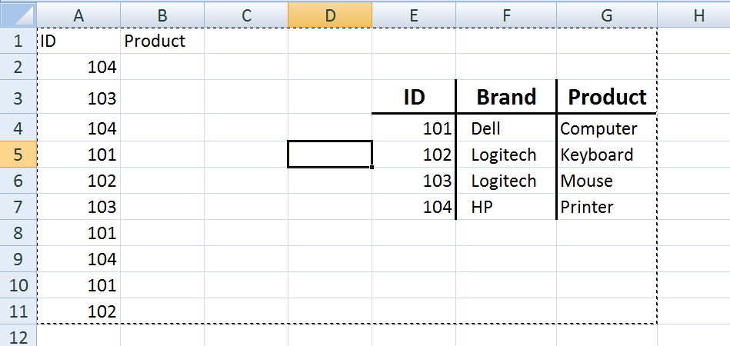
Example

Slide 9
This is what you are
looking for:
e.g. the car make,
the publisher,
the occupation, the ID
In our example it will be A2

Slide 11
This is the entire table
that you are using to
get the value you want
In our example it is E4 to G7

Slide 13
You must use ABSOLUTE referencing (dollar signs) in the table array – e.g. $f$4:$g$16 if you need to use the autofill option

Slide 14
Which column
of the table has
your value? The
first column you
selected will be
column 1.
If you are looking for the brand it will be the 2nd column.
If you are looking for the product it will be the 3rd column

Slide 16
If you choose FALSE
then an exact match
must be found.
If you choose TRUE
then it will find the
closest match.
This can be omitted

Slide 17
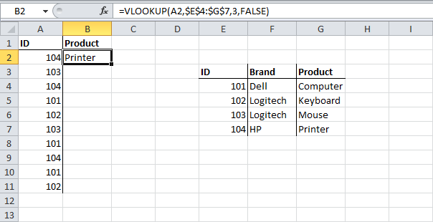

Slide 18
What do you want to look up?
Where is you information?
Which column is the info?
This is not needed

Slide 19
Round
Round
Needs the number and the number of decimal places
Roundup
Needs the number and the number of decimal places
Rounddown
Needs the number and the number of decimal places
Int
Needs the number
Trunc
Needs the number and the number of decimal places

Slide 21
Text Functions
Even though Excel is used a lot for its calculation capabilities, it has some very powerful text functions.
This enhances the program and gives it many features that enable it to deal with data

Slide 22
Text Functions - Left
This function peels off a number of characters from the left.
The text
reference
How many
chars

Slide 23
Text Functions - Right
This function peels off a number of characters from the right.
The text
reference
How many
chars

Slide 24
Text Functions - Mid
This function peels off a number of characters from the middle. It needs an additional bit of information
The text
reference
Where do I start
How many
chars

Slide 26
Text Functions - Concatenate
The English word Concatenate means “Join together” And that is what we are going to do. We are going to join 2 or more strings together to form another string

Slide 27
Joining strings together
=concatenate(String1, string2, str……… etc) Or
=cell1&cell2&cell3 ……etc
OR

Slide 28
Text Functions - Len
This counts how many characters there are in a string.

Slide 29
Text Functions - Value
Converts a text field number to an actual number. E.g. all phone numbers are stored as text. This will peel off the number so that it can be used in calculations

Slide 30
Text Functions - Find
Gives the number of characters up to and including the required text. Useful for finding spaces.

Slide 31
Text Functions – Upper (or Lower)
Converts the selected text to UPPER (or LOWER) case

Slide 32
Text Functions - Trim
Removes EXTRA spaces between words

Slide 33
Date and Time-
Now() | Today() | Day(cell ref)
Month(cell ref) | Year(cell ref) | Date(yy,mm,dd)
Days(cell ref1,cell ref2) | Hour(cell ref) | Minute(cell ref)
Time(hh,mm,ss)

